Slide 1
Chapter 20: Architecture Reconstruction and Conformance
Pingjian Zhang
School of Software Engineering, SCUT
2018

Slide 2
Chapter Outline
Architecture Reconstruction Process
Raw View Extraction
Database Construction
View Fusion
Architecture Analysis: Finding Violations
Guidelines
Summary

Slide 3
Why Reconstruction?
System already exists, but you do not know its architecture.
never recorded.
recorded but the documentation has been lost.
recorded but the documentation is no longer synchronized with the system after a series of changes.
How do you maintain such a system?
How do you manage its evolution to maintain the quality attributes that its architecture has provided?

Slide 4
Purposes of Reconstruction
To document an architecture where the documentation never existed or where it has become hopelessly out of date
To ensure conformance between the as-built architecture and the as-designed architecture.
In architecture reconstruction, the as-built architecture is reverse-engineered from existing system artifacts.

Slide 5
Reconstructing Mappings
When a system is initially developed, its architectural elements are mapped to specific implementation elements: functions, classes, files, objects, and so forth.
When we reconstruct those architectural elements, we need to apply the inverses of the original mappings:
Use automated and semi-automated extraction tools
Probe the original design intent of the architect.
Typically we use a combination of both techniques

Slide 6
Tools for Reconstruction
Architecture reconstruction is a tool-intensive activity.
Tools extract information about the system, typically by scouring the source code.
They may also analyze other artifacts as well, such as build scripts or traces from running systems.
We need tools that aid in building and aggregating the architectural abstractions that we need.

Slide 7
…but not Just Tools
Architecture reconstruction tools are not a panacea.
It may not be possible to generate a useful architectural representation.
Not all aspects of architecture are easy to automatically extract.
Architecture reconstruction is an interpretive, interactive, and iterative process involving many activities; it is not automatic.
It requires the skills and attention of both the reverse-engineering expert and, in the best case, the architect.

Slide 8
Reconstruction Workbenches
An architecture reconstruction workbench should be open and provide an integration framework whereby new tools that are added to the tool set do not impact the existing tools or data unnecessarily.

Slide 9
Reconstruction Phases
Raw view extraction.
Raw information about the architecture is obtained from various sources, primarily source code, execution traces, and build scripts.
Each of these sets of raw information is called a view.
Database construction.
Convert the raw extracted information into a standard form
Use that to populate a reconstruction database.
We will use the database to generate authoritative architecture documentation.

Slide 10
Reconstruction Phases
View fusion and manipulation.
View fusion can improve the overall accuracy.
Can’t infer runtime behavior of static views.
Architecture analysis.
View fusion will result in a set of hypotheses about the architecture that need to be tested to see if they are correct.
If not, repeat earlier steps.
Notes:
Example: a static view extracted from source code might miss dynamically bound information such as calling relationships. This could then be combined with a dynamic view from an execution trace, which will capture all dynamically bound calling information, but which may not provide complete coverage.

Slide 11
Reconstruction Phases

Slide 12
1. Raw View Extraction
Raw view extraction involves analyzing a system’s existing design and implementation artifacts to construct models of it.
These views will be refined later to support reconstruction goals
Blend of the ideal and the practical
Identify and capture the elements of interest from the source artifacts (code, header files, build files, and so on) and other artifacts (e.g., execution traces).
Notes:
(what information do you want to discover about the architecture that will most help you meet the goals of your reconstruction effort?)
(what information can your available tools actually extract and present?)

Slide 13
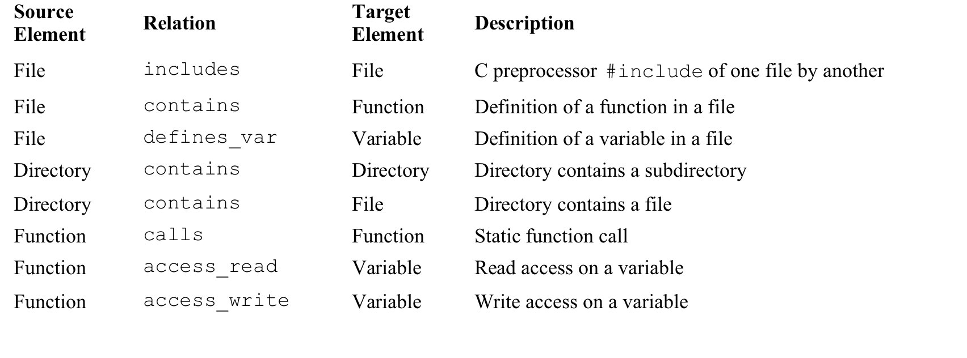
Typical List of Extracted Elements and their Relationships

Slide 14
Static vs. Dynamic Information
Static information is obtained by observing only the system artifacts.
Dynamic information is obtained by observing how the system runs.
Some architecturally relevant information may not exist in the source artifacts because of late binding.
The precise topology of a system may not be determined until runtime.
The goal is to fuse both to create more accurate system views.
May need to use tools that can generate dynamic information about the system.
Notes:
Polymorphism
Function pointers
Runtime parameterization
Plug-ins
Service interactions mediated by brokers

Slide 15
Common Tools for View Extraction
Tool | Description
Parsers | Parsers analyze the code and generate internal representations from it
 | Build AST tree for more further analysis
AST analyzers
Lexical analyzers | Produce tokens
Profilers | Output information about the code as it is being executed
Code instrumentation tools | Intrusive tools to monitor systems

Slide 16
2. Database Construction
Raw views may be too specific to aid in architectural understanding.
“White noise” view showing all relations of a particular sort: Accurate, but not helpful

Slide 17
2. Database Construction
Use a database to store the extracted information
Amount of information being stored is large
The manipulations of the data are tedious and error-prone if done manually.
Some reverse-engineering tools encapsulate a database, and so the user of the tool need not be concerned with its operation.

Slide 18
3. View Fusion
Extracted views are manipulated to create fused views.
Fused views combine information from one or more extracted views, each of which may contain specialized information.
Creating a fused view is creating a hypothesis about the architecture to aid in analysis.
These hypotheses result in new aggregations that show various abstractions or clusterings of the elements.
By interpreting these fused views, it is possible to produce hypothesized architectural views of the system.
These views can be interpreted, further refined, or rejected.
There are no universal completion criteria for this process.

Slide 19
Example of a Fused View
Table shows early results from the tool SonarJ. SonarJ first extracts facts from a set of source code files and lets you define a set of layers and vertical slices through those layers in a system. SonarJ will instantiate the user-specified definitions of layers and slices and populate them with the extracted software elements.

Slide 20
4. Architectural Analysis: Finding Violations
View fusion gave us a set of hypotheses about the architecture.
These hypotheses take the form of architectural elements and relationships among them.
These hypotheses need to be tested to see if they are correct.
Figure 20.4 shows the results of adding relationships and constraints to the architecture initially created in previous figure. These relationship and constraints are information added by the architect, to reflect the design intent.
In this example, the architect has indicated the relationships between the layers.
Using these relationships and constraints, a tool such as SonarJ is able to automatically detect and report violations of the layering in the software.

Slide 21
Figure 20.4

Slide 22
What Does the Figure Tell Us?
Data layer (row 2) can access, and hence depends on, the DSI layer.
Data layer may not access, and has no dependencies on, Domain, Service, or Controller (rows 1, 3, and 5).
The JUnit component in the “External” component is defined to be inaccessible.
No portion of the application should depend upon JUnit, because this should only be used by test code.

Slide 23
Finding a Violation
SonarJ has found a violation: the arc between the Service layer and JUnit.

Slide 24
Finding Dynamic Violations
To analyze the runtime architecture of the Duke’s Bank, the code was “instrumented” using AspectJ.
The figure shows that a “database write” connector was discovered in the dynamic analysis of the architecture.
The documented architecture of Duke’s Bank forbids such connections.
All database access is supposed to be managed by entity beans, and only by entity beans.
This would be difficult to find just analyzing the source code.

Slide 25
Guidelines
Have a goal and a set of objectives or questions in mind before undertaking an architecture reconstruction project.
Obtain some representation, however coarse, of the system before beginning the detailed reconstruction process. This representation serves several purposes, including the following:
It identifies what information needs to be extracted from the system.
It guides the reconstructor in determining what to look for in the architecture and what views to generate.
Identifying layers is a good place to start.

Slide 26
Guidelines
The existing documentation for a system may not accurately reflect the system as it is implemented.
Tools can support the reconstruction effort and shorten the reconstruction process, but they cannot do an entire reconstruction effort automatically.
The work involved in the effort requires the involvement of people who are familiar with the system.

Slide 27
Summary
Architecture reconstruction and architecture conformance are crucial tools in the architect’s toolbox to ensure that a system is built the way it was designed, and that it evolves in a way that is consistent with its creators’ intentions.
The results of architectural reconstruction can be used in several ways:
If no documentation exists or if it is seriously out of date, the recovered architectural representation can be used as a basis for documenting.
It can be used to recover the as-built architecture, or to check conformance against an “as-designed” architecture.
The reconstruction can be used as the basis for analyzing the architecture or as a starting point for reengineering the system.
The representation can be used to identify elements for reuse or to establish an architecture-based software product line.

Slide 28
Summary
The software architecture reconstruction process comprises the following phases:
Raw view extraction
Database construction
View fusion
Architecture analysis

